Slide 1
Week 1
Distributions: Central tendency and variability

Slide 2
Course overview
Goals
Content
Primary focus is on concepts.
Allow you to use multiple methods when examining data in your work.
Interpret results and assess the quality of an analysis.
Provide text, notes, video, lectures, data, and a GUI.
“Stats with Steve” team site will have files and is a place to ask questions about the course.
US Dept. of Health’s Covid-19, Titanic, and Motor Trend car data.

Slide 3
Statistical learning
Following themes discussed in the “How to Think About Statistics” book.
Importance in understanding concepts.
Subsequent concepts are built off of prior concepts.
Understanding concepts can help identify opportunities for investigation and to show the most useful results.

Slide 4
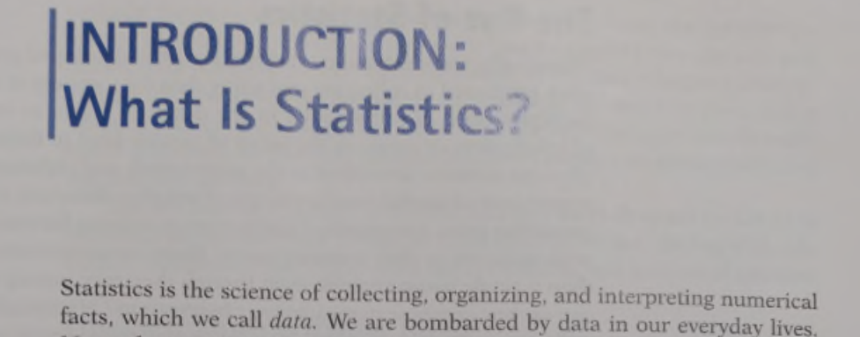
What is statistics? (in Moore & McCabe)

Slide 5
What do we do in a statistical analysis?
Describe the sample or population. We examine the center, spread, and shape of a distribution.
Make inferences from the sample onto the population (i.e., my sample is part of a larger population). Is one group’s sample part of the same population? Does a group’s center and spread differ from the population?

Slide 6
Stuff a statistician does
Plans a study
Produces graphs and performs statistical tests
Interprets results
Tells a story with data: Many parts, each graph or statistical test can make up a chapter in the story. In other words, we rely on multiple analyses.

Slide 7
Distributions
Center, spread, and shape

Slide 8
Levels of measurement
Nominal: Named levels (med center name, medical record number).
Ordinal: Rank-ordered, distances between levels are not assumed equal or meaningful (1st, 2nd, 3rd places in a baking contest).
Interval: Rank-ordered and meaningful distances between levels. But has no 0 (SAT scores).
Ratio (ounces, money)
Importance in determining which statistical test to select.

Slide 9
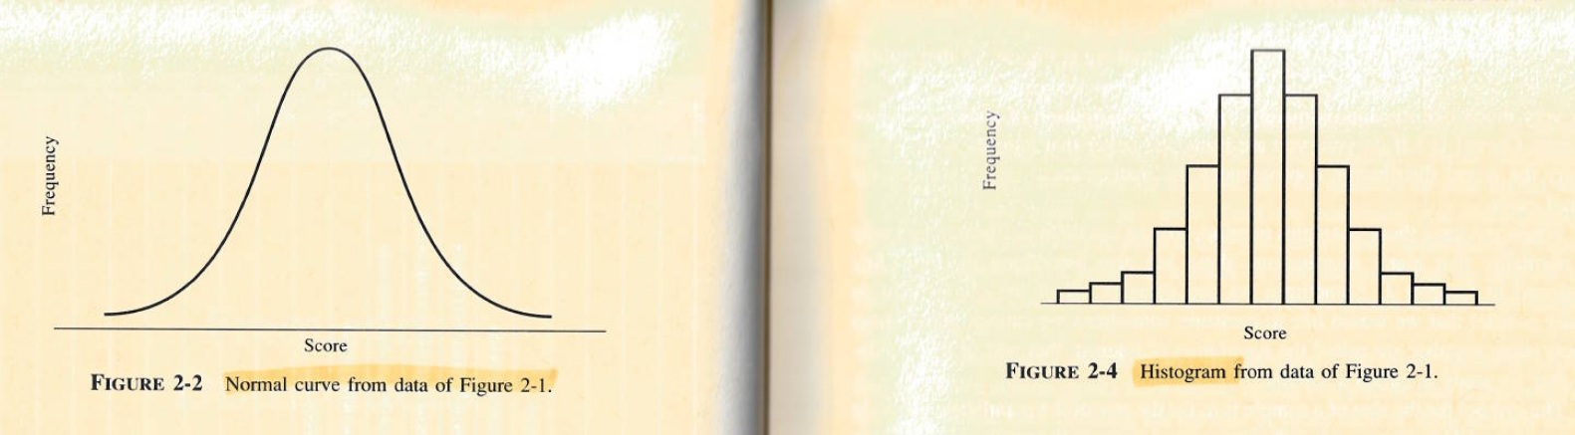
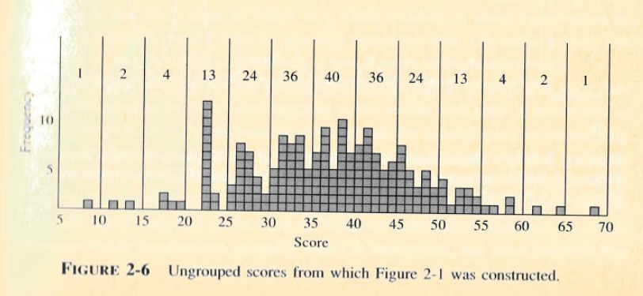
Normal distribution: Curve and histogram
Each bin contains the count of cases with that range of value. For example, 40 people had scores between 35 and 40.

Slide 10
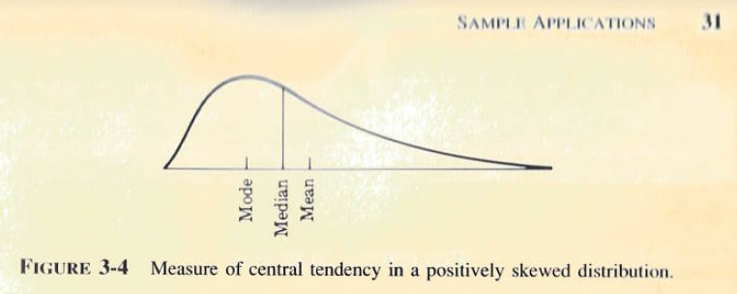
The center or “average”: Mean, median, mode

Slide 11
Measures of variability (mtcars data)
Percentiles: Percent of the distribution at which X percentile falls below that value. E.g., 19.2 is 50th percentile or median in miles-per-gallon. 50% percent of cars in the sample have MPG at or below 19.2.
IQR: The distance between the 25th to 75th percentiles (IQR= 22- 15.4 = 7.4 for MPG).
Range: The lowest and highest values (MPG: 10.4 and 33.9).
5 number summary: The range and quartiles (25th, 50th, 75th percentiles). For MPG, it is: 10.4, 15.4, 19.2, 22, 33.9.
Standard deviation: The average squared deviation around the mean.

Slide 12
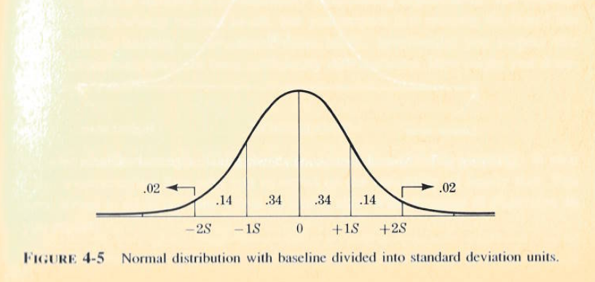
Proportion of data within 1 and 2 standard deviations of the mean.
68 - 95 - 99.7 rule for 1-2-3 SDs

Slide 13
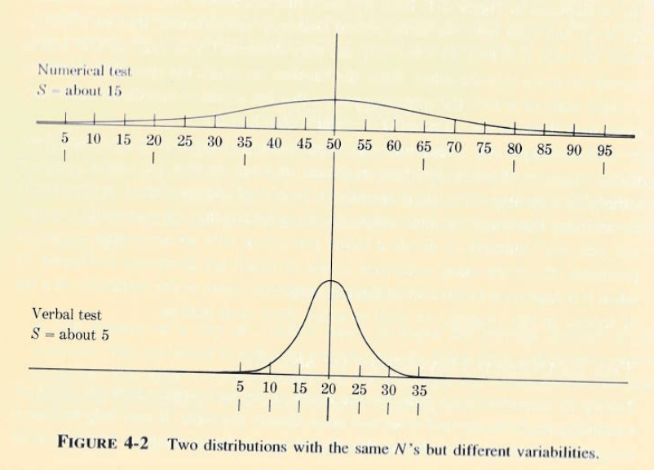
Data with the same mean but different variability can look very different
S = standard deviation

Slide 14
Change over time
In January 2020, beds were not over-utilized in the US.
As covid spread in the next 1 ½ years, bed use increased consistently across the country.

Slide 15
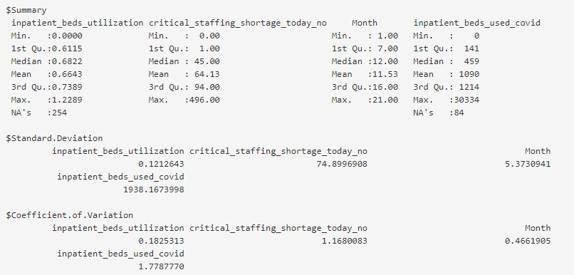
Summary of variables from covid data (center and spread)
COV= SD/Mean. Not commonly used

Slide 16
Special considerations
Non-normal distributions are common. We can still use the mean to estimate important values. For example, length of stay values are often very skewed but stable. The mean might be 11 days and that value would be helpful for projecting staffing requirements, etc. But to describe the “average patient’s stay”, using the median of 2 days is more appropriate.
With skewed distributions, be careful about your interpretations that use SDs such as control charts. For example, the 68-95-99.7 rule fits on the IBU outcome (0.14% above) for 3 SD in a control chart but overestimates IBU-C (2.17% instead of the expected 0.15%).

Slide 17
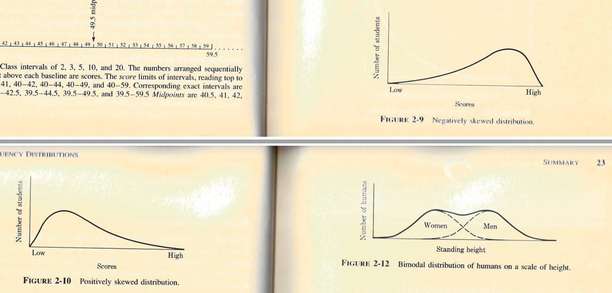
Examples of other distributions
Men and women may differ, we’ll want to examine this more.

Slide 18
Analyzing data
Using descriptive and inferential statistics to explore data

Slide 19
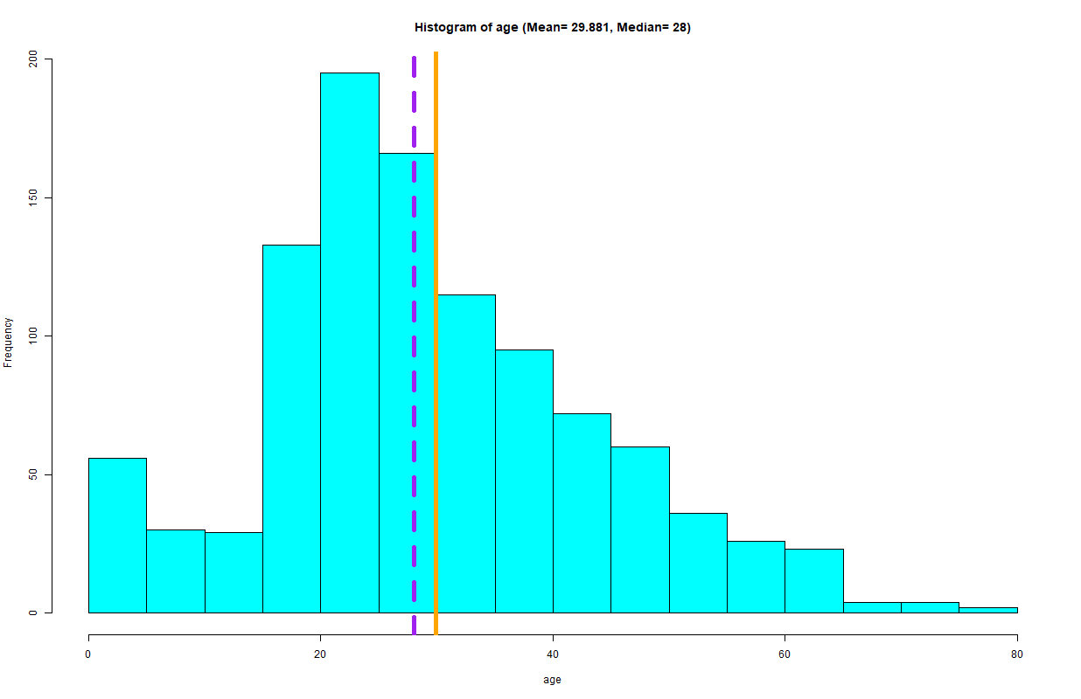
Titanic passenger age
There may never be another Titanic so let’s consider this the population of Titanic passengers. Are there groups distinct from each other in terms of age?

Slide 20
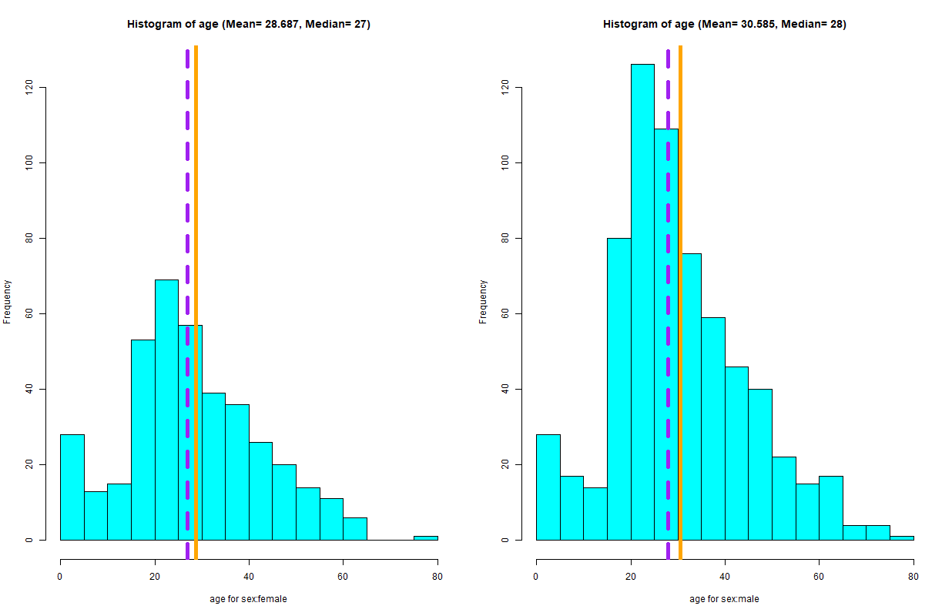
Comparing men and women
Female
Male
Narrower distribution
Higher frequency

Slide 21
Analysis and interpretation
When comparing the average ages between men and women, both distributions look alike and look similar with the overall distribution. The means and medians only differ by 1 or 2 years with men being older.
1) A statistical test shows that the difference is slightly significant (p=0.04). It meets our criteria but it doesn’t appear substantial. I examined 2) statistical power and it is weak. For example, if we repeated this experiment 100 times, we probably would only find a significant difference about ½ of the time. In other words, we shouldn’t expect to see a lot of consistency in these findings.

Slide 22
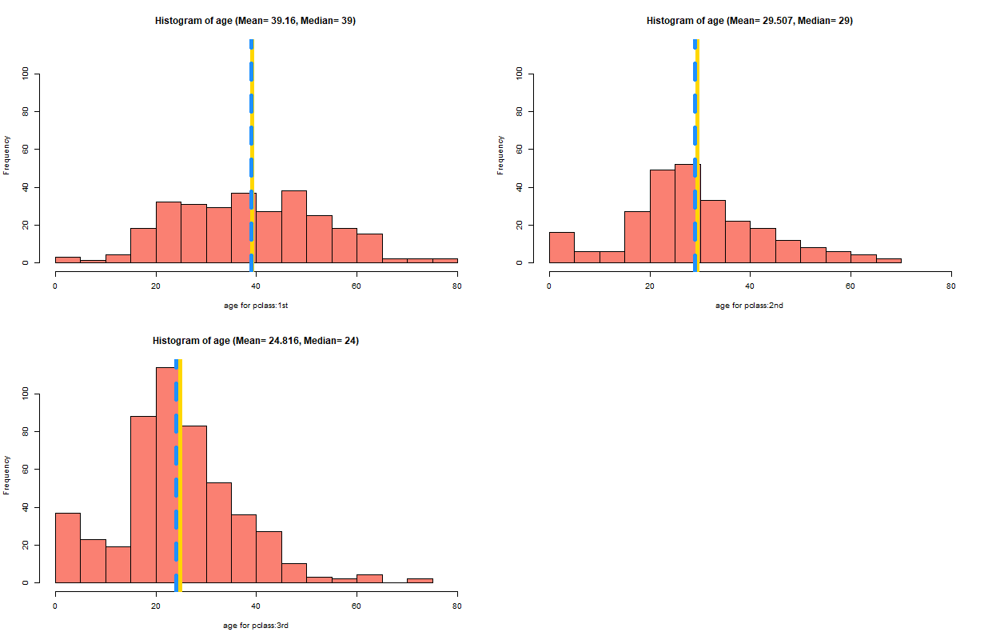
Now consider age by passenger classes

Slide 23
Analysis and interpretation
I then compared the different passenger classes and we can see that the distributions appear different. 1st class has a wider spread in ages while 3rd class clumps up around the younger ages.
1) A statistical test shows a significant difference (p=0.001) with a very high level of 2) statistical power (100%). If the 15 year difference in average age seems important, then we can say we have substantial findings.

Slide 24
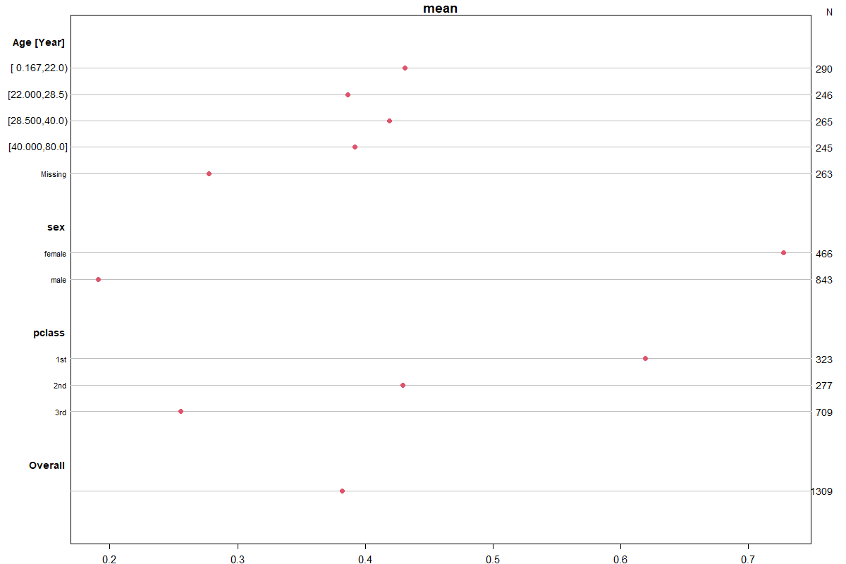
Titanic survival: Using descriptive statistics to identify trends/differences between groups
Somewhat linear trend in age quartiles
Big differences in distributions between men and women
Different distributions and linear trend for passenger classes.
Red dots above the “overall” dot might have above average chances

Slide 25
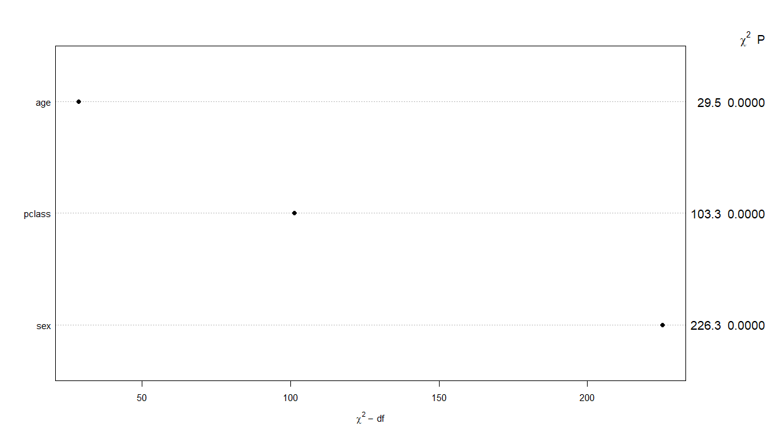
Variable importance from a regression confirms descriptive analysis on Titanic data
Most important variable.
All 3 are statistically significant.

Slide 26
Appendix A
Skewness and Kurtosis

Slide 27
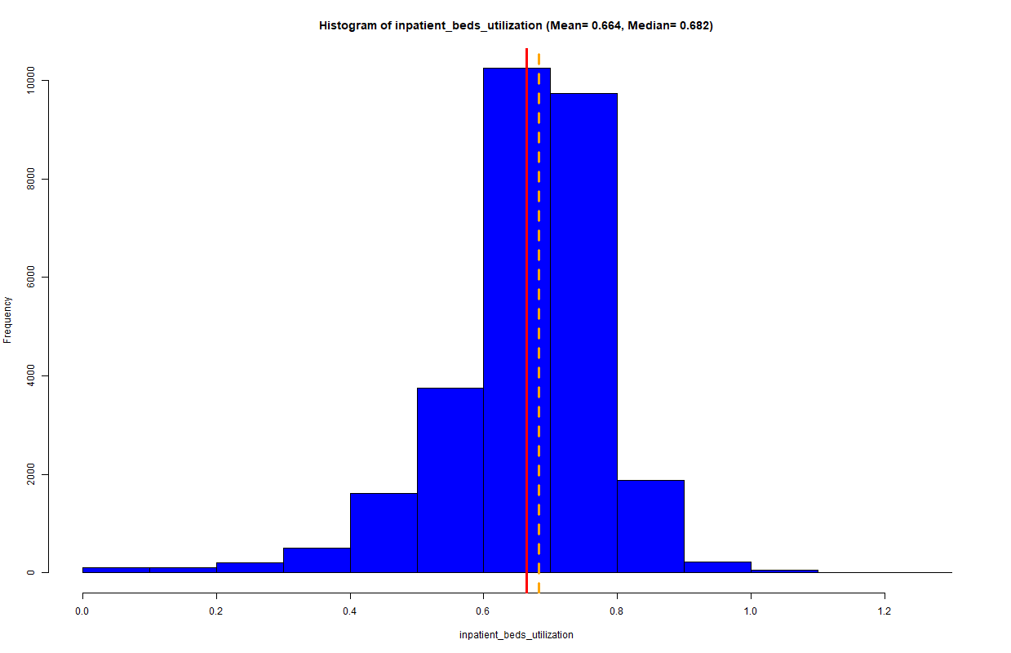
Normal distribution with a slight left tail (Mesokurtic with a slight negative skew)
We can tell it has a negative skew because the tail drifts off to the left which pulls the mean to the left of the median. But the mean and median are still relatively close.
Left tail

Slide 28
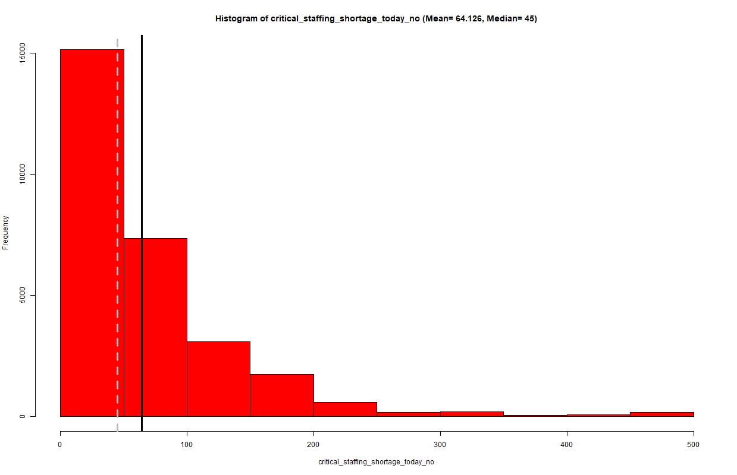
Right tail (Positive skew)
The right tail is another description of a positive skew. The tail drifts off to the right which pulls the mean towards the high values and to the right of the median
Right tail

Slide 29
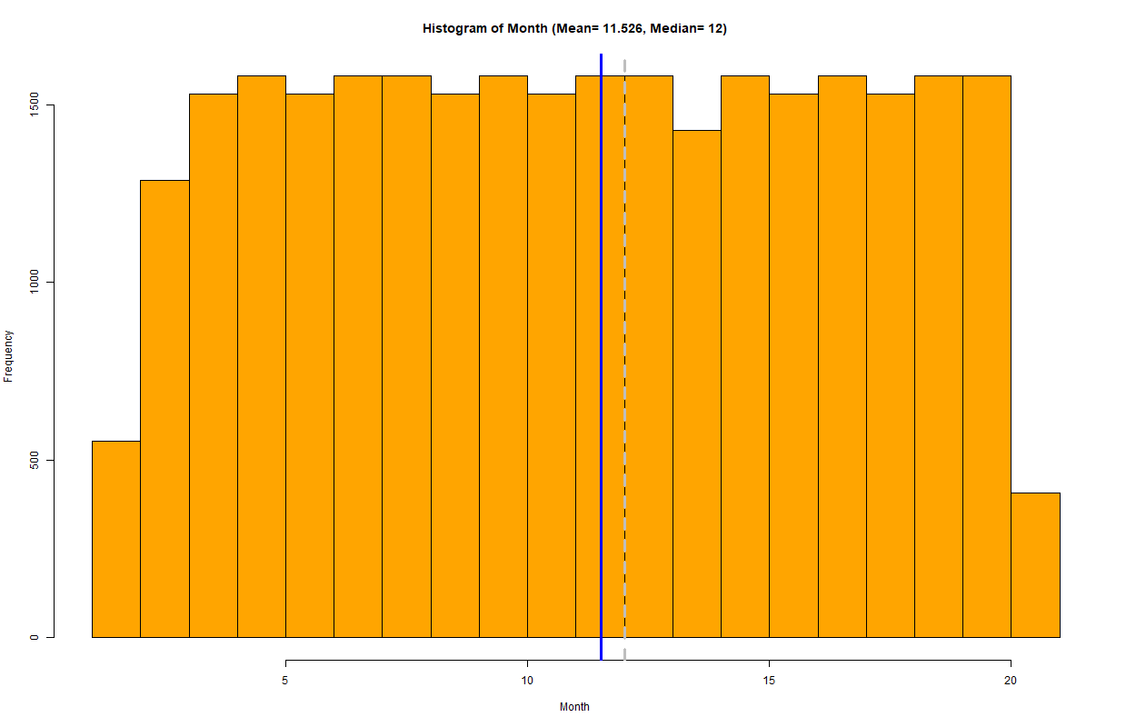
Wide spread distribution and heavier tails (Platykurtic, almost a “uniform distribution”)
With a standard deviation of 5.37 and a coefficient of variation 0.47, we may think of it as a slight “normal distribution”.
The mean is to the left of the median and suggests a minor left tail.

Slide 30
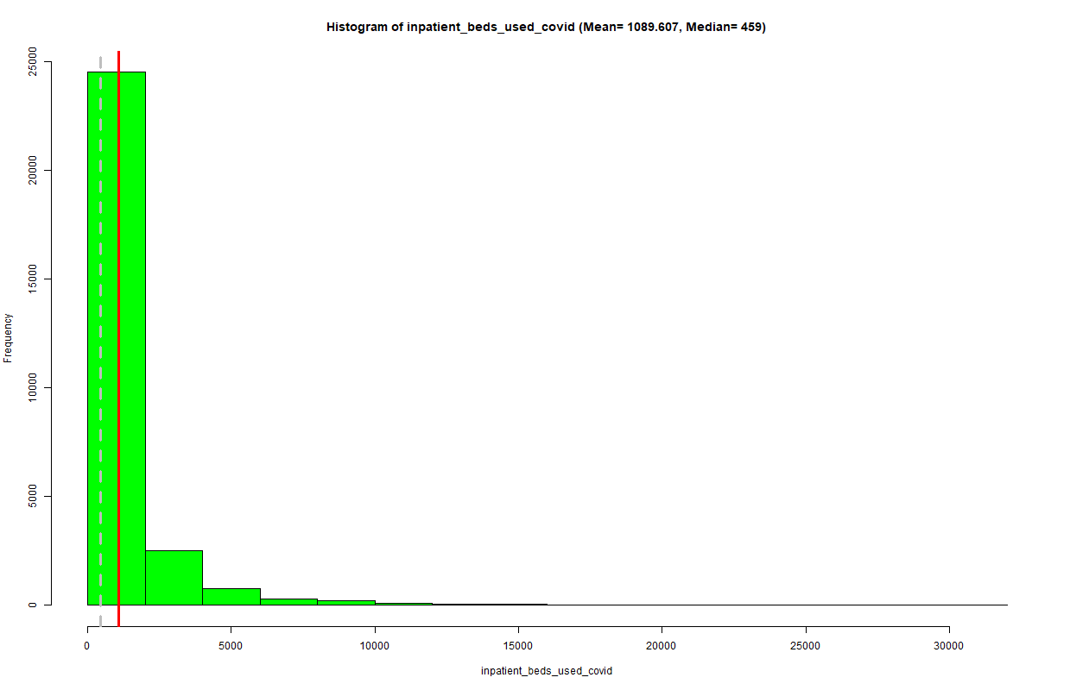
Narrow distribution with a right tail (Leptokurtic and positive skew)
Graphing is helpful for understanding a distribution but we need to be careful not to overlook important statistical properties.
This variable has the highest COV even though it appears to have the least variation. The reason is how the standard deviation is calculated and because highly skewed data inflates the SD.
Although the distribution is skewed, you can still make use of the mean (e.g., cost projections). It is the estimation of the standard deviation and is most impacted by skewed data.

